Slide 1
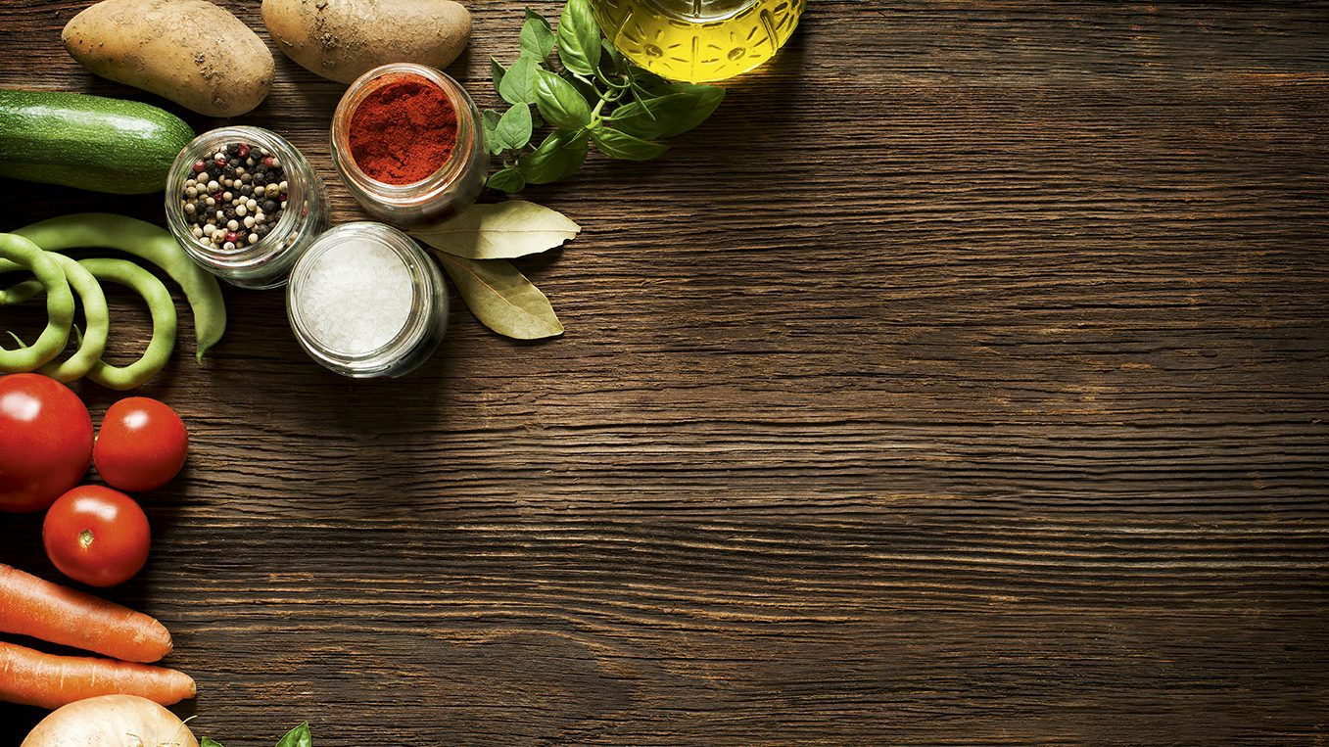
Deep-Learning
Ethan Liew
S10223273E

Slide 2
Contents
Overview
Data Preprocessing
Developing models from scratch
Developing models from pretrained models
Evaluate models using Test images
Use best model to perform classification
Summary

Slide 3
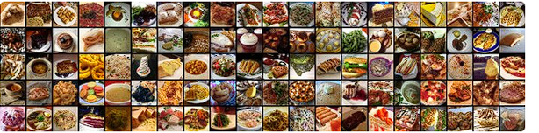
Overview
Information about data:
-6GB
-from kaggle
-1000 images per category
-101 different foods

Slide 4
Overview
development process:
start with a base model→test different overfitting techniques→ develop more/less complex models → apply best techniques learnt from base model onto new models
Test different pretrained models → use best performing one to be unfrozen —> apply overfitting techniques

Slide 5
Data preprocessing
-download the dataset from kaggle
-perform subsetting using python script
-python script also sorts into train test validation sets
-load data into jupyter notebook

Slide 6
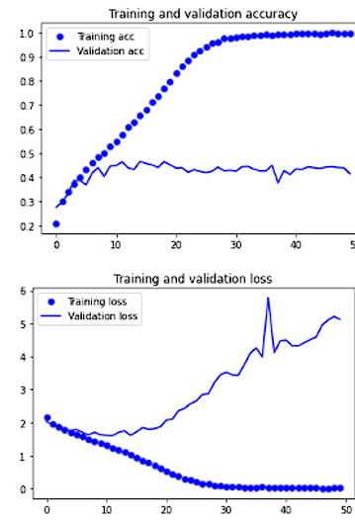
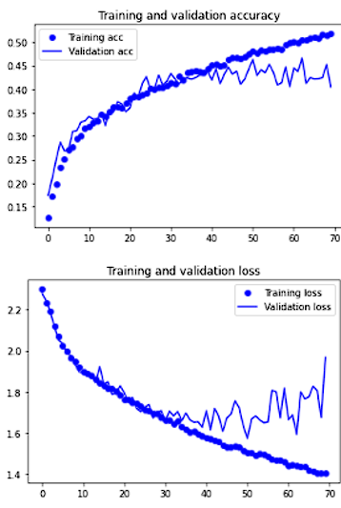
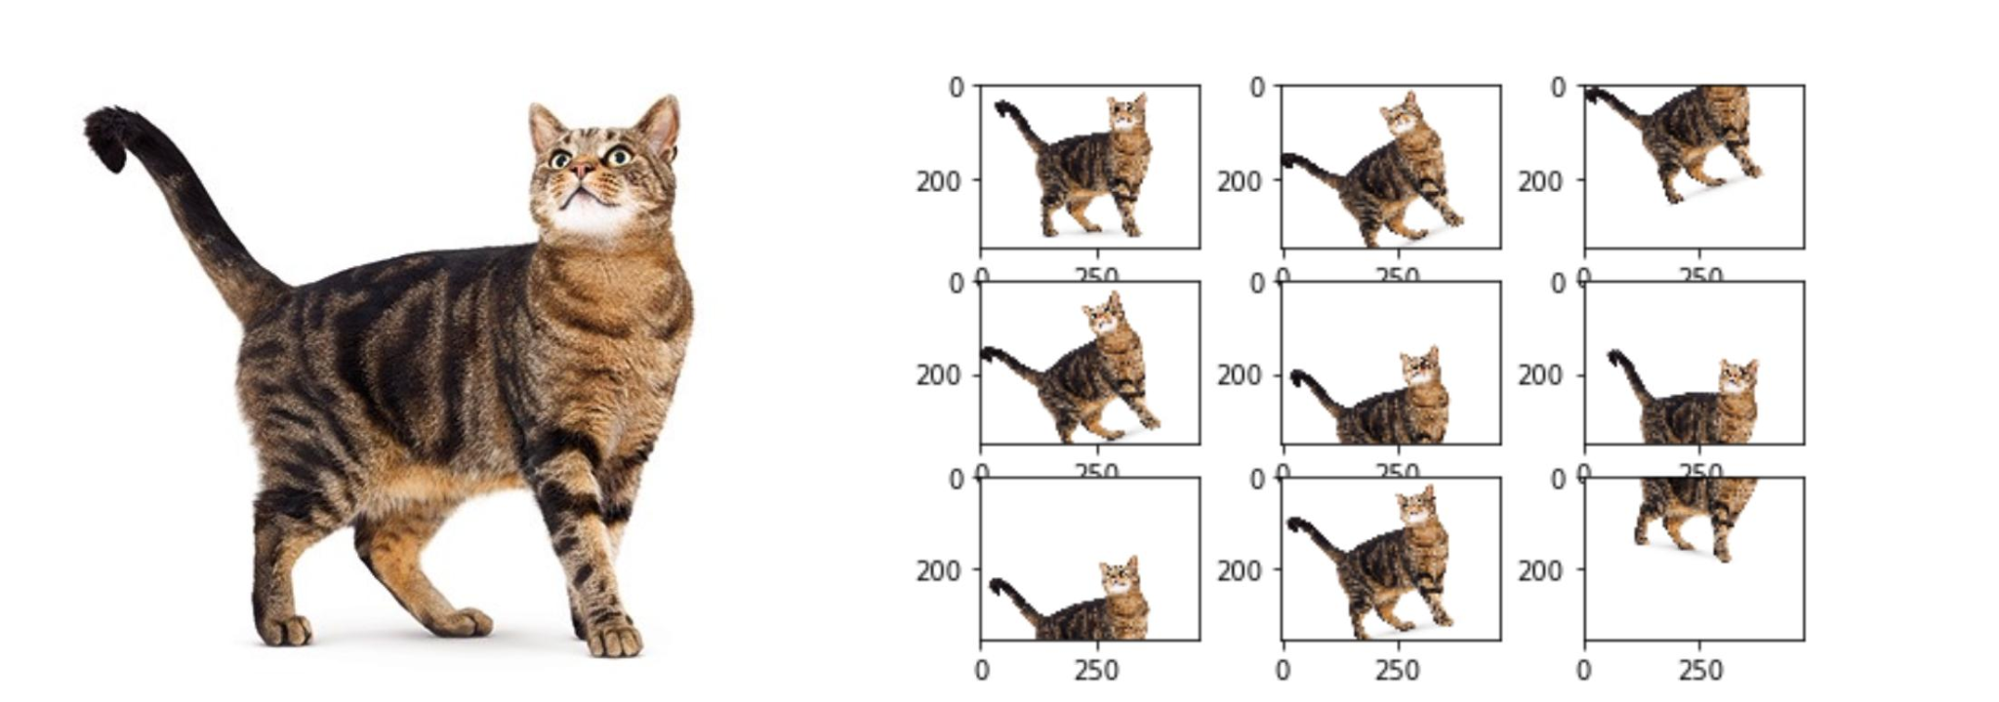
Data preprocessing
data augmentation:
-what?
artificial increase in data
-why?
-does it work?

Slide 7
Data preprocessing
data generators:
-used to load data
-convert images to numbers
-stores configuration for data augmentation
-rescale rgb
-batch size 50
-image size 150

Slide 8
Developing models from scratch
Data augmentation vs no data augmentation

Slide 9
Developing Models from scratch

Slide 10
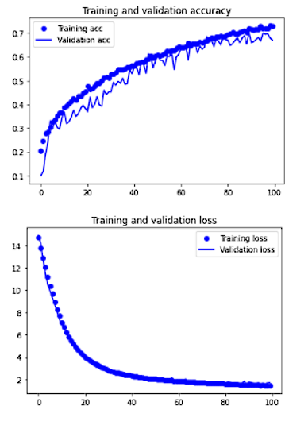
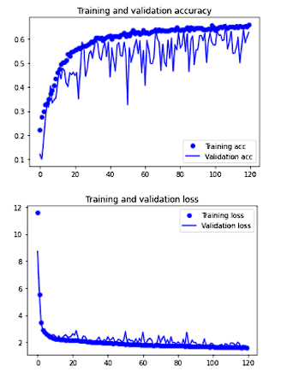
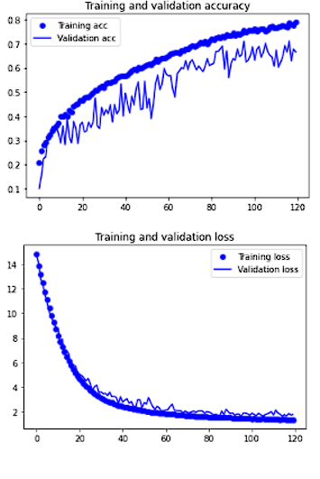
Developing models from scratch
testing different optimizers:
rmsprop adadelta adam

Slide 11
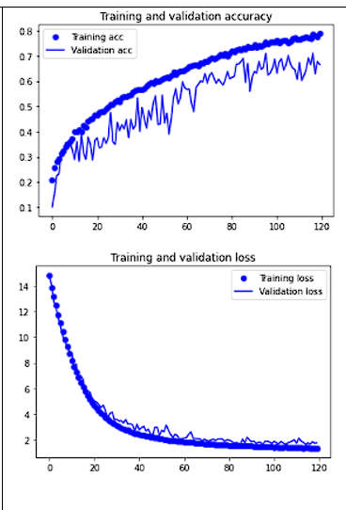
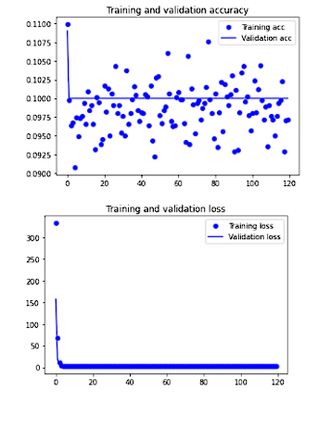
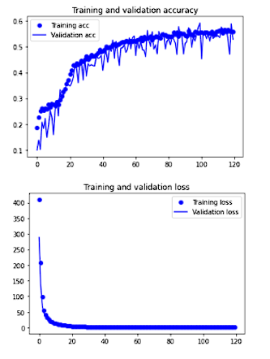
Developing models from scratch
regularizers and normalization:
l2 with normalization
l1 without normalization
l1 with normalization

Slide 12
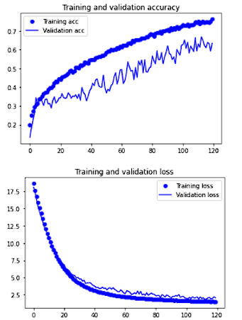
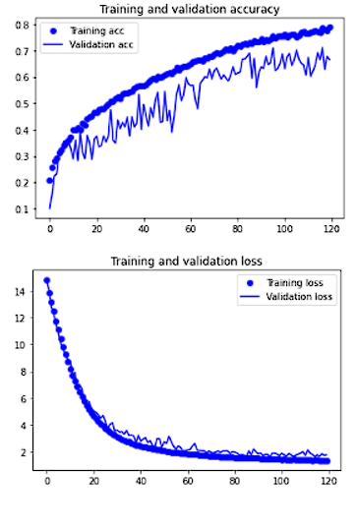
Developing models from scratch
kernel initializer :
he normal initializer
without he normalizer

Slide 13
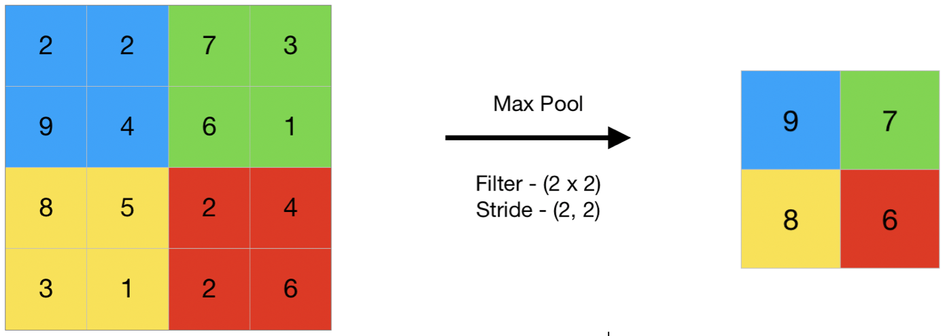
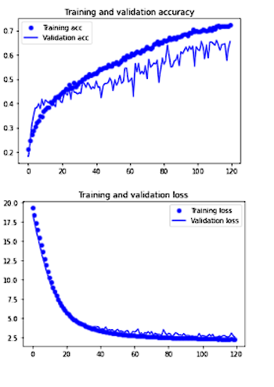
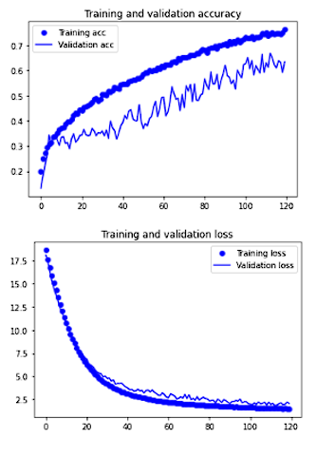
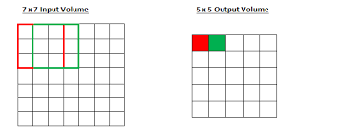
Developing models from scratch
striding and max pooling:
striding
max pooling

Slide 14
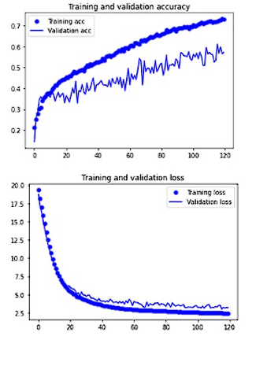
Developing models from scratch
padding no padding

Slide 15
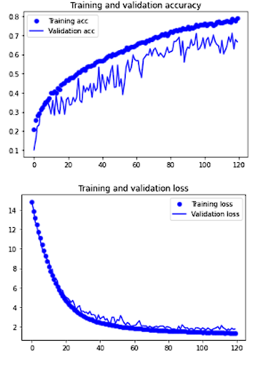
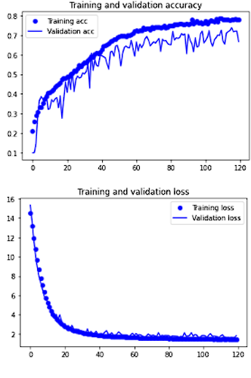
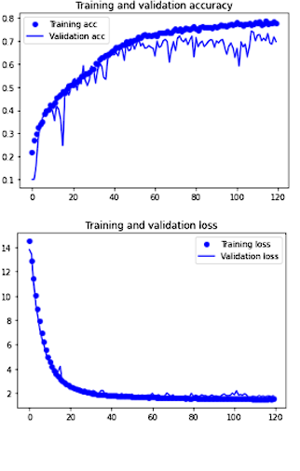
Developing models from scratch
learning rates +
lr = 0.0001
lr = 0.00017
lr =0.0002

Slide 16
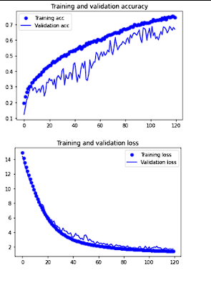
Developing models from scratch
learning rates -
lr = 0.0001
lr = 0.00003

Slide 17
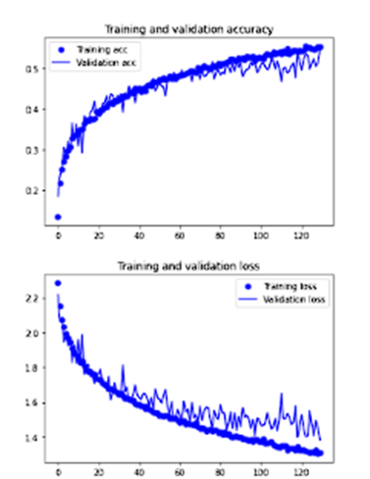
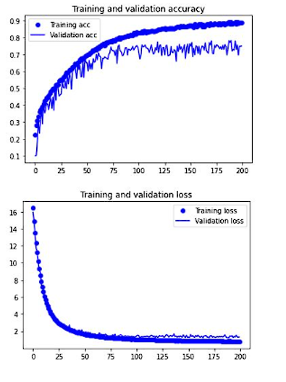
Developing models from scratch
simple model
complex model

Slide 18
Developing Pretrained Models

Slide 19
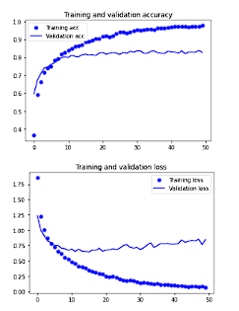
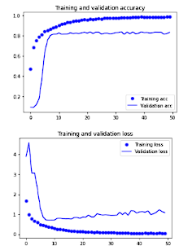
Developing pretrained models
inceptionv3
resnet50

Slide 20
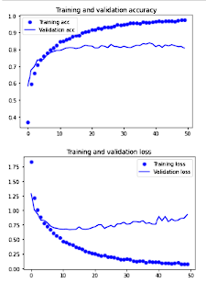
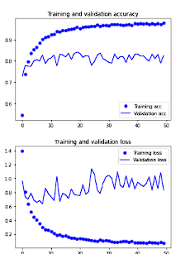
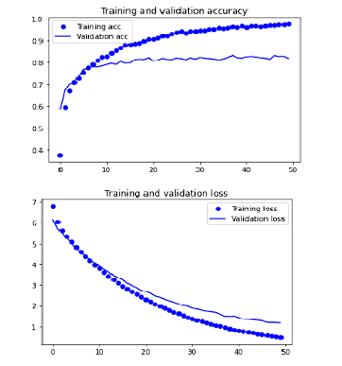
Developing pretrained models
increasing dense layer node
unfreezing layers + overfitting prevention
unfreezing layers

Slide 21
Evaluating models

Slide 22
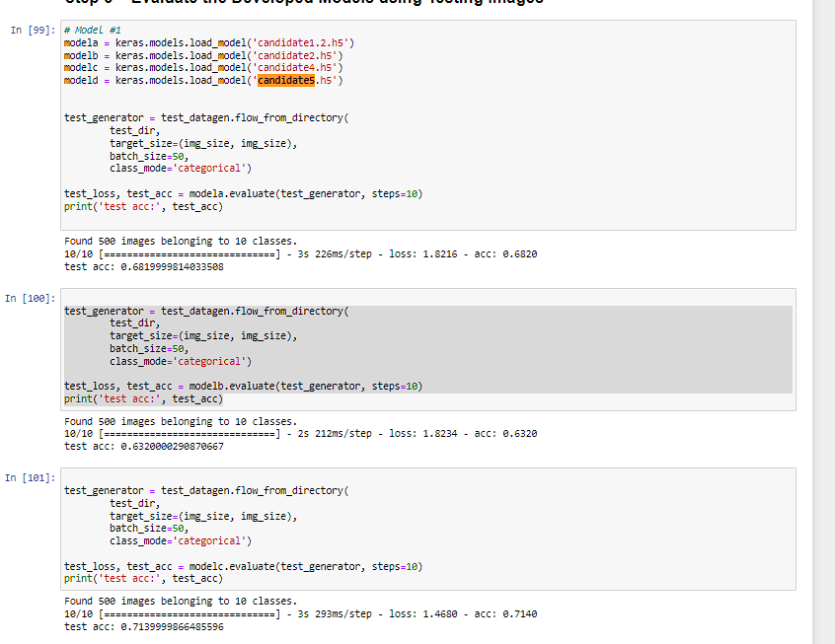
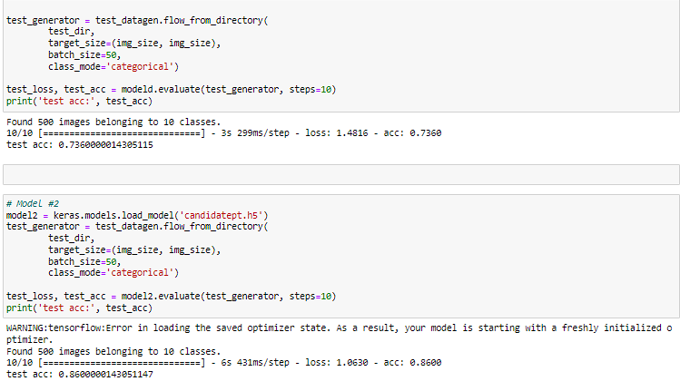
evaluating models
best performing model built from scratch as well as model build from pre-trained model

Slide 23
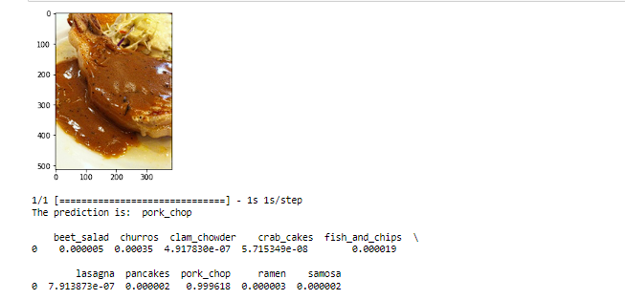
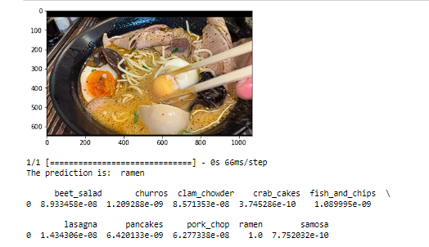
Using best model for prediction

Slide 24
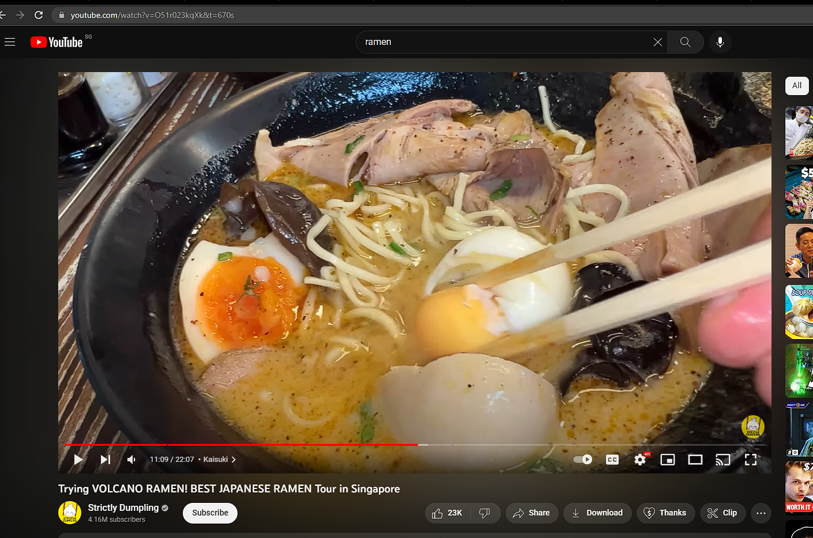
using best model for prediction
https://www.youtube.com/watch?v=O51r023kqXk&t=670s
11:10 for exact picture

Slide 25
Further improvements
-ensemble learning
-more training data
-different train test validation ratio (80 5 15)

Slide 26
references
https://arxiv.org/pdf/1207.0580.pdf)
http://mipal.snu.ac.kr/images/1/16/Dropout_ACCV2016.pdf)
https://www.youtube.com/watch?v=O51r023kqXk&t=670s

Slide 27
Thank you

